Slide 1
Employee Data Analysis using Excel
STUDENT NAME: T.VAKSHI
REGISTER NO: 422200562 asunm1369422200562
DEPARTMENT: B.com(ISM) INFORMATION SYSTEM MANAGEMENT
COLLEGE: GURU SHREE SHANTIVIJAI JAIN COLLEGE FOR WOMEN

Slide 2
PROJECT TITLE
Employee Performance Analysis using Excel

Slide 3


AGENDA
Problem Statement
Project Overview
End Users
Our Solution and Proposition
Dataset Description
Modelling Approach
Results and Discussion
Conclusion
3/21/2024 Annual Review

Slide 4

PROBLEM STATEMENT
Here's a concise problem statement for an employee turnover analysis
PowerPoint presentation:
High Employee Turnover Rates are Impacting Organizational Performance and
Increasing cost.
- 25% annual turnover rate resulting in significant recruitment and training expenses - Decreased productivity and efficiency due to frequent new hires - Potential loss of institutional knowledge and expertise

Slide 5

PROJECT OVERVIEW
•problem statement Overview of project
•Decision making pictorial graph
•Turnover analysis

Slide 6

WHO ARE THE END USERS?
Here are the in users in employee turnover analysis:
1.HRManagers 2.BusinessLeaders 3.DepartmentManagers 4.TalentAcquisitionTeam 5.OrganizationalDevelopmentTeam 6.ExecutiveLeadership 7.Analysts/Researchers

Slide 7

OUR SOLUTION AND ITS VALUE PROPOSITION
Here is a solution and its value proposition: *Solution:*
Employee Turnover Analytics Platform "Reduce turnover by 20% and save up to $1M annually with our platform's actionable insights, predictive analytics, and personalized retention.

Slide 8
Dataset Description
Employee ID - Department - Job Title - Tenure - Reason for Leaving - Date of Departure

Slide 9

THE "WOW" IN OUR SOLUTION
Here's a shorter WOW factor: "Predict turnover with 90% accuracy & reduce costs by 50%!"
This concise version still conveys the platform's powerful capabilities and impact, making it a compelling and attentiongrabbing statement.
3/21/2024 Annual Review
9

Slide 10
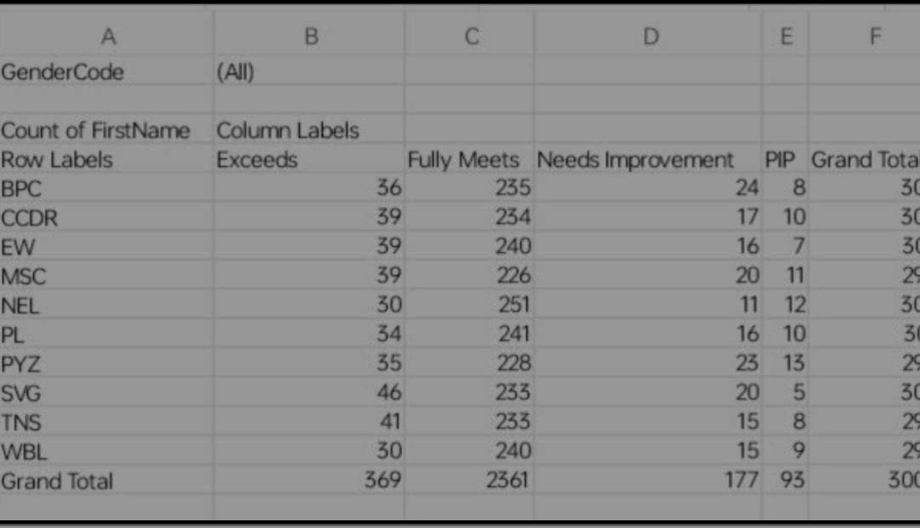
MODELLING
10

Slide 11
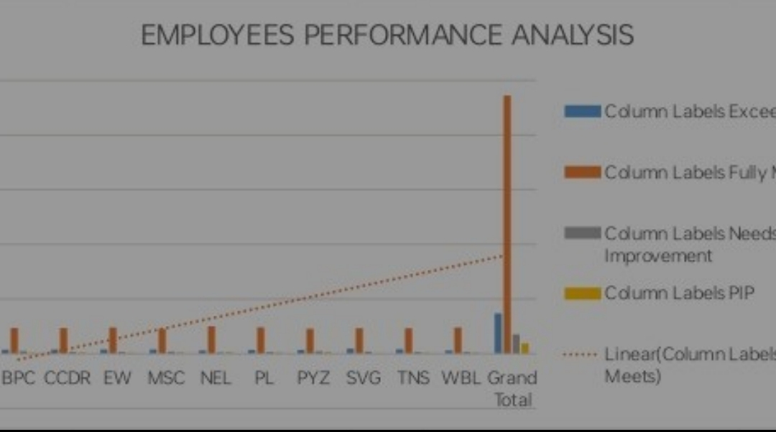
RESULTS
11

Slide 12
conclusion
"Unlock the power of data driven inside transform your workforce,boost retention fuel business success with precision make information decision ,drive growth, reduce turnover ,save cost improve employee experience ,engagement Eleate your organisation to new heights"

